Slide 1
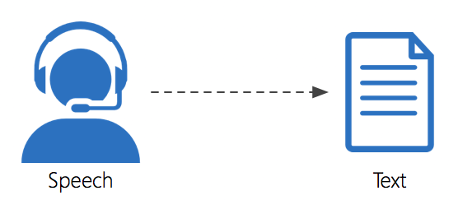
SPEECH TO TEXT
RISHI CRISPIN J
URK22EC1066

Slide 2
INTORDUCTION
When it comes to our interactions with machines, things have gotten a lot more complicated. We’ve gone from large mechanical buttons to touchscreens. However, hardware isn’t the only thing that’s changing. Throughout the history of computers, the text has been the primary method of input. But thanks to developments in NLP and ML (Machine Learning), Data Science, we now have the means to use speech as a medium for interacting with our gadgets in the near future.
Virtual assistants are the most common use of these tools, which are all around us. Google, Siri, Alexa, and a host of other digital assistants have set the bar high for what’s possible when it comes to communicating with the digital world on a personal level.For the first time in the history of modern technology, the ability to convert spoken words into text is freely available to everyone who wants to experiment with it.
When it comes to creating speech-to-text applications, Python, one of the most widely used programming languages, has plenty of options

Slide 3
History of Speech to Text
Before diving into Python’s statement to text feature, it’s interesting to take a look at how far we’ve come in this area. Listed here is a condensed version of the timeline of events:
Audrey,1952: The first speech recognition system built by 3 Bell Labs engineers was Audrey in 1952. It was only able to read numerals.
IBM Shoebox (1962): Coils can distinguish 16 words in addition to numbers in IBM’s first voice recognition system, the IBM Shoebox (1962). Had the ability to do basic mathematical calculations and publish the results.

Slide 4
Defense Advanced Research Projects Agency(DARPA) (1970): Defense Advanced Research Projects Agency (DARPA) (1970): DARPA supported Speech Understanding Research, which led to the creation of Harpy’s ability to identify 1011 words.
Hidden Markov Model(HMM), the 1980s: Problems that need sequential information can be represented using the HMM statistical model. This model was used in the development of new voice recognition techniques.
Voice search by Google,2001: It was in 2001 that Google launched its Voice Search tool, which allowed users to search by speaking. This was the first widely used voice-enabled app.
Siri,2011: A real-time and convenient way to connect with Apple’s gadgets was provided by Siri in 2011.

Slide 5
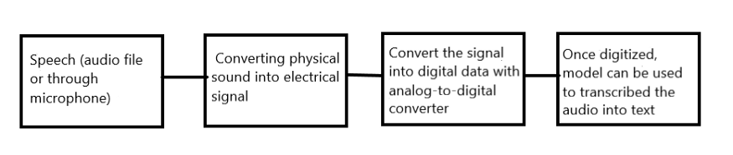
BLOCK DIAGRAM

Slide 6
STEPS INVOLVED
Steps
Import library for speech recognition
Initializing the recognizer class in order to do voice recognition. We аre utilizing Gооgle’s sрeeсh reсоgnitiоn teсhnоlоgy.
The following audio formats are supported by speech recognition: wav, AIFF, AIFF-C, and FLAC. In this example, I utilized a ‘wav’ file.
I’ve utilized an audio clip from a ‘stolen’ video that states “I have no idea who you are or what you want, but if you’re seeking for ransom, I can tell you I don’t have any money.”
Google recognizer reads English by default. It supports a variety of languages; for further information, please refer to this documentation.

Slide 7
Applications of Speech Recognition
Evolution in search engines
Healthcare industry
Service industry
Service providers

Slide 8
CODE

Slide 9
OUTPUT

Slide 10
DISADVANTAGES
Imprecise interpretation
Speech recognition does not always accurately comprehend spoken words. VUIs (Voice User Interfaces) are not as proficient at comprehending contexts that alter the connection between words and phrases as people are. Thus, machines may have difficulty comprehending the semantics of a statement.
Accents
VUIs may have difficulty comprehending dialects that are not standard. Within the same language, people might utter the same words in drastically diverse ways.
Background noise and loudness
In a perfect world, these would not be an issue, but that is not the case, and hence VUIs may struggle to operate in noisy surroundings (public spaces, big offices, etc.).

Slide 11
Conclusion
A speech-to-text conversion is a useful tool that is on its way to becoming commonplace. With Python, one of the most popular programming languages in the world, it’s easy to create applications with this tool. As we make progress in this area, we’re laying the groundwork for a future in which digital information may be accessed not just with a fingertip but also with a spoken command

